Slide 1

Natural Language Processing and GenAI (AAI-520-01) Team 6: Context-Aware Movie Chatbot: Multi-Turn Conversations with Sentiment-Driven Responses
By Anand Fernandes, Outhai (Thai) Xayavongsa and Saad Saeed

Slide 2
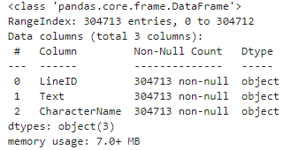
Introduction
Objective:
Develop a generative chatbot using the Cornell Movie Dialogs Corpus to handle multi-turn,
context-aware conversations.
Dataset:
Utilized over 300,000 movie dialogues from the Cornell Movie Dialogs Corpus for training.
Model Selection:
After experimenting with models like LSTM and GPT-2, T5 was chosen for its sequence-to-sequence capabilities and proficiency in managing context across multi-turn dialogues.
Goal:
Create a chatbot capable of generating coherent and contextually appropriate responses, while improving dialogue quality through iterative training and evaluation.
Notes:
The goal of this project was to develop a generative chatbot using the Cornell Movie Dialogs Corpus, which contains over 300,000 movie dialogues. This large dataset of movie dialogues was ideal for training a chatbot capable of handling multi-turn conversations. After trying LSTM and GPT-2, we settled on T5, a model known for its sequence-to-sequence capabilities and ability to manage conversational context. Ultimately, our goal was to create a chatbot that generates coherent and context-aware responses. Thia will discuss about the challenges it comes with.

Slide 3
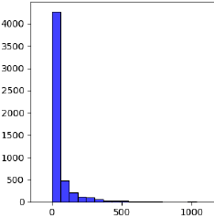




Challenges
Data Imbalance
Cleaning Complexity
Dialogue Data
Special Characters
Training Stability
Hardware Limitations
Regularization Methods
Required efficient GPU
Notes:
Thank you Saad. Let’s talk about some challenges we’ve faced. First, data imbalance posed an issue, with a few characters dominating the dialogue, it affected response diversity. Second, cleaning the dataset was complex due to special characters and inconsistencies in movie dialogues. Third, maintaining training stability for the T5 model required significant adjustments and regularization to prevent overfitting. Lastly, hardware limitations, especially the need for an efficient GPU, constrained our training process, requiring careful management of resources. Despite these challenges, our team adapted and found solutions to progress effectively.

Slide 4
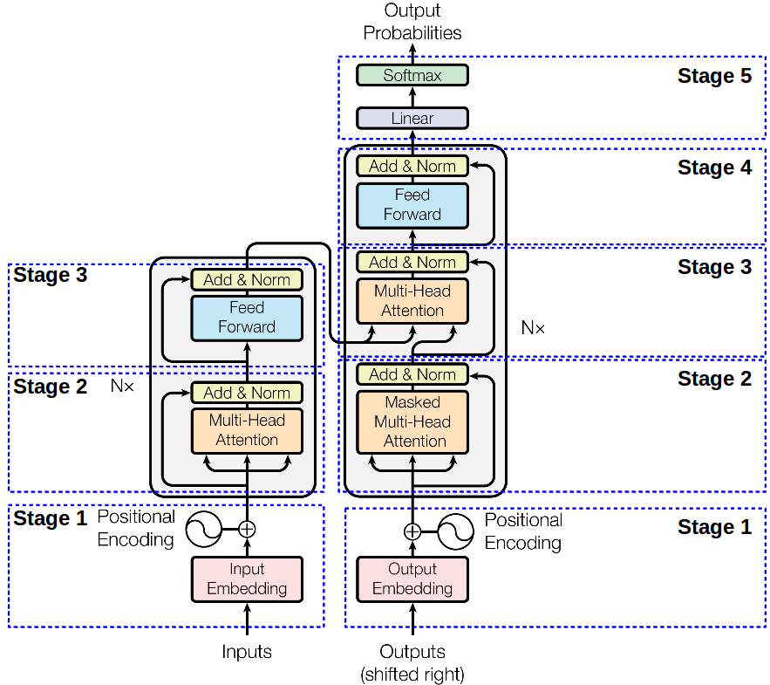
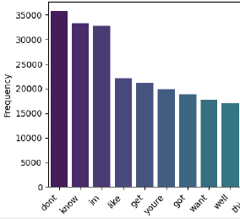
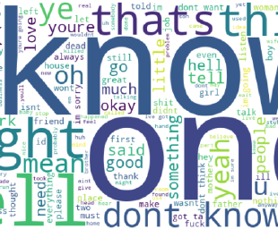

Key Findings
Robust T5 Architecture
Effective Preprocessing
Good Text Generation
Conversational Phrases
Dialogues to coherent responses
Tokenization
Lemmatization
Remove Rare Words
Short Dialogue Generation
“know”
“ok”
This Photo by Unknown Author is licensed under CC BY-SA
Notes:
The T5 model demonstrated its strength by effectively learning from dialogues to generate coherent responses. Key preprocessing steps—like tokenization, lemmatization, and removing rare words—significantly improved its conversational understanding. The chatbot produced relevant short dialogue responses, successfully handling casual prompts, with frequent usage of phrases like 'know' and 'okay,' highlighting the informal style of movie dialogue.

Slide 5
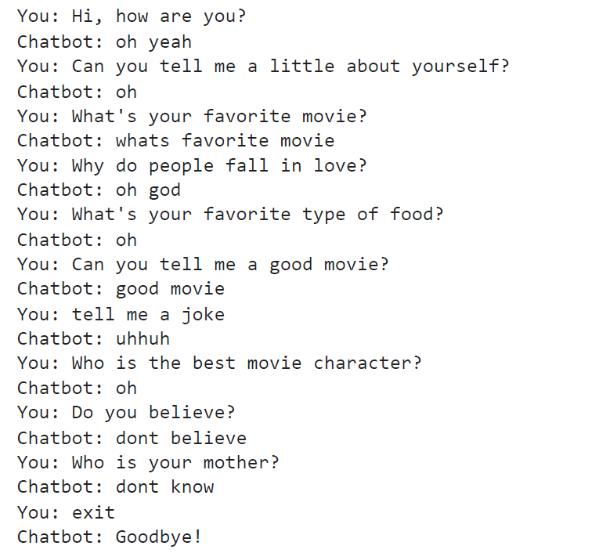
Chatbot
Basic Interaction: Shallow, random.
Emotion Responses: Lacks context.
Abstract Queries: Repetitive, no creativity.
Commands: Follows simple cues.
Improvements: Larger dataset, context memory, sentiment analysis.
Notes:
The chatbot utilizes the T5 model, trained on the Cornell Movie Dialogs Corpus. Essentially, it generates responses by understanding the context of user prompts. Let’s review the chat. For example, when asked, 'Hi, how are you?', the chatbot responds with 'oh yeah'. This shows basic engagement, though the depth is quite limited. It similarly struggles with abstract or creative questions, such as 'Why do people fall in love?', where it responds with 'oh god', showing an attempt at an emotional response but without depth or relevance.
In contrast, simple commands like 'exit' are correctly understood, as the bot appropriately responds with 'Goodbye!' This tells us that the model can follow direct instructions but lacks the sophistication needed for more conversational tasks. To improve, we’d focus on training it on larger, more diverse datasets, adding context memory, sentiment analysis, and using rule-based filtering for improved response quality.

Slide 6
Model Selection for Generative Chatbot
Models
Explored Models: GPT-2, LSTM, and T5.
T5 Chosen: Chosen for its strong sequence-to-sequence capabilities.
Why T5?
Handles context in multi-turn conversations effectively.
Produces more coherent and relevant responses.
Minimal debugging compared to other models.
Comparison
GPT-2 struggled with coherence.
LSTM had difficulty managing long-term dependencies.
T5 excelled at maintaining context-awareness.
Notes:
In the beginning, we faced difficulties with model coherence using LSTM and GPT-2. These models struggled with context, resulting in irrelevant responses. We switched to T5 for its robustness in handling complex, multi-turn conversations. T5 excels at sequence-to-sequence tasks, making it perfect for our chatbot project. We compared models based on their ability to maintain context, and T5 consistently outperformed the others in conversational flow and relevance.

Slide 7
Data Preprocessing for Chatbot Training
Using Dataset: Cornell Movie Dialogs Corpus.
Preprocessing Steps:
Tokenization: Split text into individual tokens.
Stopword Removal: Removed irrelevant common words (e.g., "the", "is").
Lemmatization: Converted words to their base forms.
Handling Rare Words: Replaced words appearing fewer than 5 times with <UNK> token to improve generalization.
Final Dataset: Cleaned dialogue pairs ready for training.
Notes:
The raw dataset had mixed metadata and dialogue formats, requiring careful extraction of conversation pairs. We used custom parsing functions to structure the data. After that, we applied tokenization, stopword removal, and lemmatization to clean the text. Rare words were replaced with a special ‘<UNK>’ token to help the model generalize better by focusing on more common terms. These preprocessing steps were critical in ensuring the model received well-structured input for training.

Slide 8
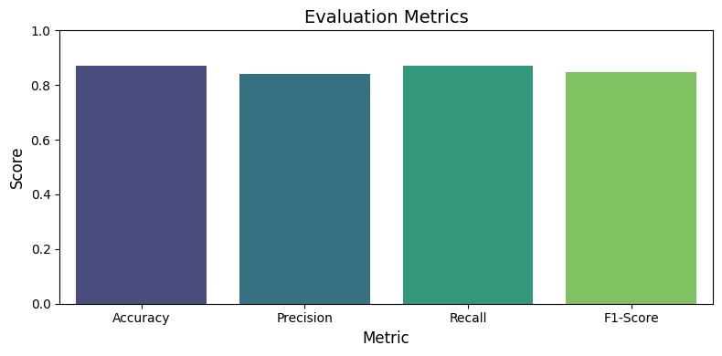
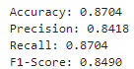
Training and Evaluation Results
Model Training: Trained T5 model over 20 epochs.
Batch size reduced to prevent memory overload.
Used regularization to reduce overfitting.
Performance Metrics:
Notes:
We trained the T5 model on the cleaned dataset over 20 epochs, with consistent improvements in training loss. We encountered GPU memory overload, which we solved by reducing the batch size and optimizing memory with PyTorch’s memory management functions. The model achieved promising results with an accuracy of 87%, a precision of 84%, and an F1-score of 85%, indicating strong performance in generating relevant responses. We monitored both training and validation losses to avoid overfitting, ensuring the model's generalization to unseen data.

Slide 9
Relevant Recommendations/Conclusion
Model Variants Exploration:
Fine-Tuning:
Investigate larger T5 variants (e.g., T5-base, T5-large) for improved conversational depth.
Compare the performance of these models against T5-small to understand potential benefits.
Further fine-tune hyperparameters (example: temperature) to generate more diverse and contextually accurate responses.
Training on Diverse Datasets:
Evaluation Methods:
Introduce additional dialogue datasets to enhance the chatbot’s response diversity and reduce repetitive outputs.
Develop qualitative evaluation techniques to better assess conversation coherence beyond standard metrics.
Notes:
Say this : For future improvements, we suggest experimenting with T5-base or T5-large to enhance conversational depth and diversity. Although T5 performed well, the model still produced generic responses to open-ended questions, highlighting the need for better fine-tuning. Talk about additional techniques: "We also recommend further tuning hyperparameters, like temperature settings, to improve the variety of generated responses. Overall, T5 demonstrated strong potential, but with further optimization, it could generate more diverse, contextually rich conversations.

Slide 10
Contributions
Anand Fernandes – Team member Contributed to chosen data Data Collection, Load, and Data Understanding Model Design and Training using LSTM PPT – Relevant Recommendations or Conclusion - Recording only | Saad Saeed – Lead Assist Submit all deliverables Contributed to chosen data Clean data & EDA Model Evaluations and Metrics using T5 Report – Challenges faced, and solutions implemented Report – Format, length, and APA 7 Check PPT – Developments and Findings (Intro, Model Selection, Data Preprocessing, Training & Evaluation) Anand’s Section PPT – Relevant Recommendation or conclusions PPT – Format, Timing, APA 7 check | Outhai Xayavongsa – Team Lead Create Task and Organize meetups Preprocessing and Visuals after Model Design & Training using T5 Model Evaluation & Metrics Created Chatbot Create GitHub & ReadMe Notebook Organization & Pep 8 check Report – Model Architecture & Rationale PPT – Challenges & Key Findings PPT – Chatbot & How it works PPT – Slide with Collab Efforts Anand’s section Report – Evaluation results and user feedback Report – Future Improvements & Scalability Options
Notes:
My name is Outhai and this concludes our presentation. Thank you, Anand & Saad, for all your dedication and hard work.

Slide 11
Resources
Icons
Icon Pack: Artificial intelligence | Filled
Vector
Gradient npl illustration
Gradient quantum illustration
Gradient quantum illustration I
Gradient ssl illustration
Gradient sql illustration
Gradient sql illustration I
Gradient npl illustration

